Slide 1
Building Non-linear Narratives in
HORIZON: ZERO DAWN
Leszek Szczepański Gameplay Programmer - Guerrilla Games
@yezu
Game Narrative Summit - GDC 2017
Notes:
Horizon Zero Dawn is an open-world action role playing game, exclusive for the PlayStation 4. It is set in a lush post-post apocalyptic world where gigantic machines have taken over and humanity is no longer the dominant species.
Talk composed of two parts:
1. Research into quests, linear and non-linear narratives and quest systems in existing games.
2. How this research lead us to the development of our methods and what they are.
Good reason for this:
1. Dual responsbilities - Programmer/Designer
2. Engineer might bring a different perspective to common issues, regarding building game narratives.

Slide 2
Quests - between rules and the narrative
Quests are a way to combine narrative focused and
rules focused methods of creating, analysing and
understanding games.
Quests are about action that is meaningful to
a player on the level of ideas, personal ambitions,
benefit to society, spiritual authenticity. ¹
The meaning of quests emerges from
strategic actions, but these actions have thematic,
narrative and personal implications. ²
^{1,2} J. Howard - Quests (2008)
Notes:
Quests are a interesting concept in themselves. (in RPG, not literary studies)
Two perspectives from which one can look at games: narrative perspective and rules perspective.
Because to exist they need both.
Word meaningful is exceptionally important - meaningful choice - important idea in good game design.
Through quests player interacts with both rules and the narrative and draws meaning from both.
Summary: Design, Writing, Tech - Quests

Slide 3
Structure of a quest (in an RPG)
Composed of multiple discrete phases or steps.
Has an obvious start, middle and end.
Each step is a piece of narrative.
Often a step is connected with a Quest Log entry and one or multiple objectives visible to the player.
Usually the player is given a reward after reaching specific steps.
Notes:
To able to discuss the topic, let's look at the structure of a quest.
Progressing through a quest yields some sort of a reward, which has tangible value in the context of the game.

Slide 4
Quest Systems
In an RPG a quest system is needed to track and manage player’s progress through quests and by turn the game’s story.
The shape of the system has a significant impact on how the quests are designed and kinds of stories that can be told.
Notes:
If we have a game which story is told mainly through quests, we need a system which will allow for creation and management of said quests. Shape has implications to the kind of stories we can tell.
We used to makes FPSs before Horizon. We were tabula rasa, waiting to be filled with ideas.
To fill the gaps in our knowledge we decided to look at the games that came before and how other teams have approached the problem.

Slide 5
Quest Systems
When looking at other games we saw multiple different approaches and implementations.
However after a while a certain pattern became visible.
All quest systems could be placed on a scale describing how flexible they are and how strictly they define what a quest is.
With Relaxed and Strict systems on opposing
poles of the scale.
Notes:
Although we found many various approaches, there was a common denominator.

Slide 6
Relaxed Quest System
No centralized system managing quest progression.
No defined concept of a quest.
All logic fully managed by scripts.
Such systems allow for virtually any kind of narrative to be expressed through a quest. However at the cost of high complexity of implementation of individual quests.
Good examples: Might & Magic, Wizardry and
a lot of other RPGs created before mid 90s as well as many RPG Maker games.
Notes:
At its extreme it’s no system at all.
Because such an approach doesn’t put any limitations on us, in theory any kind of story is possible.
Intricate stories, using sophisticated storytelling techniques, using complex structures will also be very complicated to create.

Slide 7
Strict Quest System
Uses a single, centralized system for all quests.
Each quest has a defined, rigid structure.
Quests are built from predefined elements, removing the need for scripting.
Such system severely limit what kind quests can be created. However these limitations make implementation quicker as well improve communications between teams.
Good examples: Titan Quest, Sacred and other
hack’n’slash games.
Notes:
On the opposite extreme of the scale, we have the Strict Quest System. “Negative” of the relaxed.
Rigid structures make communication easier, as the whole team has a common idea what a quest is, how it is structured and how it functions.

Slide 8
Quest Systems
Nowadays it is quite rare for a game to use a system that lies on any of the extremes of the scale.
As the demand for interesting stories as well the amount of content has grown over the years, a lot of studios try to explore a middle ground, to find the perfect balance between story complexity, freedom of expression, scalability and development time.

Slide 9
Quest Systems
Vampire the Masquerade: Redemption
Two Worlds
Gothic
Skyrim
Sacred
Relaxed
Strict
RPG Maker
The Witcher 2
Titan Quest
Neverwinter Nights
Might and Magic VI
Notes:
If we were to put games on a graph representing that scale, it would look more or less like that.

Slide 10
Binding rules with the narrative
Usually there are two approaches available to merge rules with the story, in order to create a quest:
Write a story and by injecting mechanics, add gameplay to it.
Create a set of challenges and wrap a story around them.
These have been perfected over the years and tend
to work well. However, because we are translating
narrative into logic or vice versa, sometimes
cracks and inconsistencies can show.
Notes:
The other thing worth looking at is how do we merge rules with the narrative to create quests.
Two approaches, which seem obvious.
This two step process is even more evident if different people are responsible for the narrative and the challenges.
Regardless of our best efforts we might get a dissonance between rules and the narrative.

Slide 11
Requirements for our quest system
Common types of quests must be quick and easy to create.
Complex quests must not be complex to create and manage.
Focused on non-linearity.
Provide a base common language for both rules and the narrative.
Notes:
Once we learned all that, we needed to decide what our quest system would look like. What kind of stories we would like to tell and what kind of tools we would need to be able to tell them.
1) lot of content, lot of stories, living breathing world, not necessarily complex, but still interesting
2) main quest chain, intricate, multilayered, non-linear quest offering memorable challenges and numerous choices
Address the issues I mentioned earlier - of translation rules into narrative, narrative into rules.
Designers and writers have the same kind of structures, concepts in their minds, at least initially.

Slide 12
Quest Systems
Vampire the Masquerade: Redemption
Two Worlds
Gothic
Skyrim
Sacred
Relaxed
Strict
RPG Maker
The Witcher 2
Titan Quest
Neverwinter Nights
Might and Magic VI
Horizon: Zero Dawn
Notes:
More strict, because we wanted more content and rigid structures are good for quick development and good communication and cooperation between all quest teams.

Slide 13
Our approach
A lot of games, even ones with non-linear narratives, construct quests as sequences of steps. However we wanted to present the player with a probability space instead of a script to follow.
Notes:
We knew what we wanted, now we needed to detail our approach.

Slide 14
Our approach
A probability space can be well represented as a graph.
Graph theory provides many useful tools for managing graph structures, but does require technical knowledge which users of the system might not have.
Instead we drew inspiration from the world of story
writing and decided to model our system on
a technique called Wall of Sticky Notes.
Notes:
We needed a way to visualize our probability space, a metaphor that would represent it.
Graph theory is one fundamental branches of mathematics and studies the properties of the formal mathematical structures called graphs. Which can be understood as networks of points connected by lines. Essentially it is a formal study of connections between things.

Slide 15
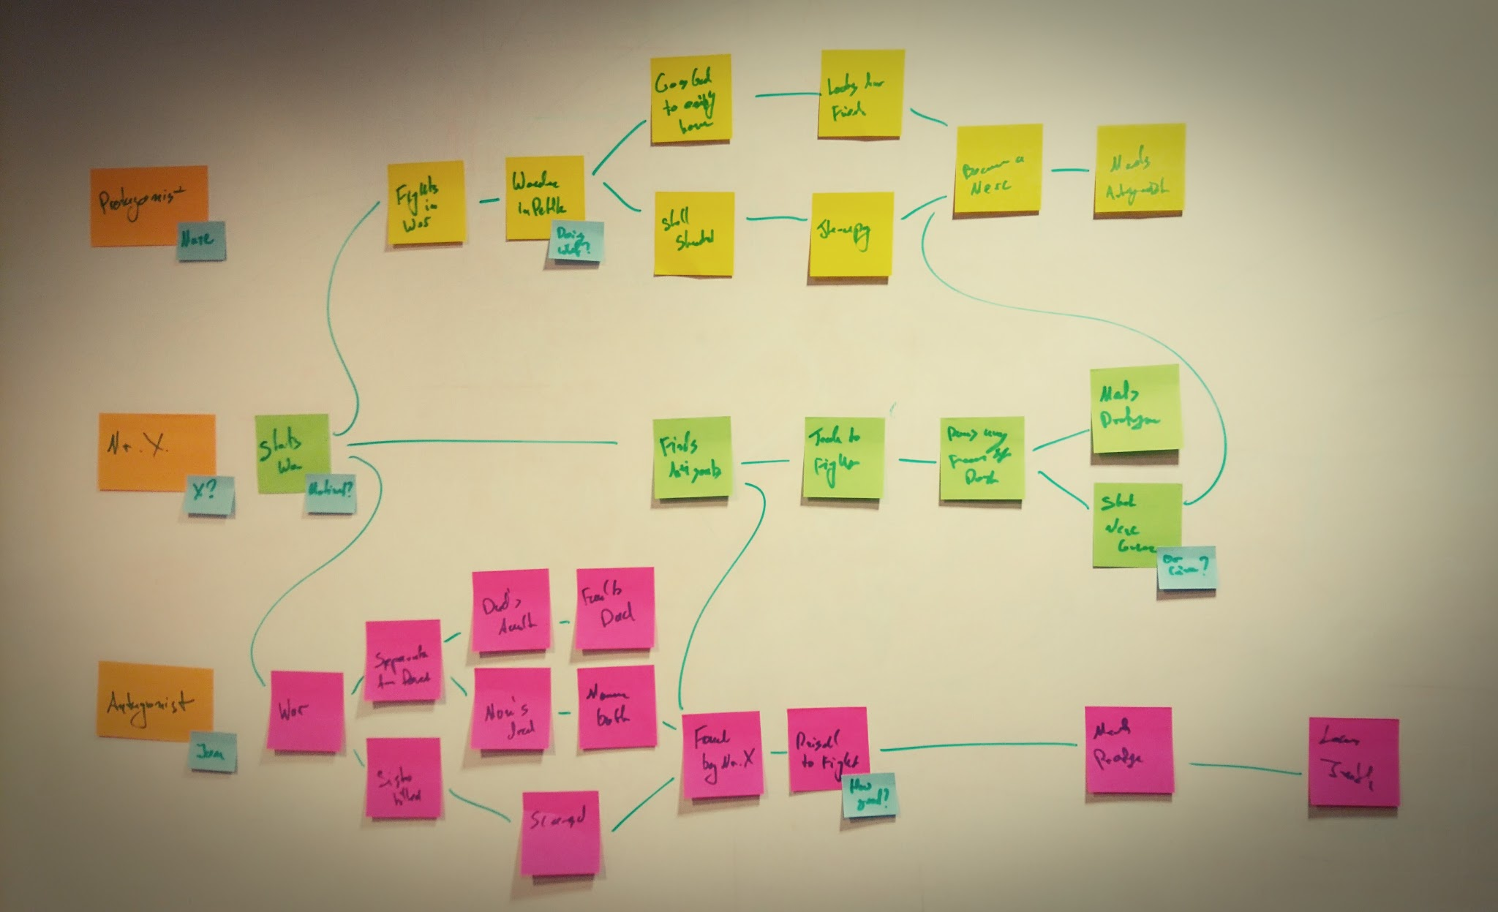
Wall of Sticky Notes
A sticky note represents a plot point or an event in the story.
Lines between notes represent cause and effect between the events.
Notes:
Protagonist encounters a distressed villager. Villager tells the protagonist that their fields are infested with terrifying insects and asks for help. Protagonist agrees and sets out to clear the fields from the insect menace. Once the last insect is killed the terrifying Insect Queen appears and attacks the protagonist. Once the Queen is slain the protagonist returns to the the villager to receive thanks and maybe rewards.
As you might imagine an event doesn't need to cause a single other event. It is possible to be the cause of multiple, creating sort of a web of cause-and-effect relationships between plot points

Slide 16
Our approach
A quest is represented as a graph of steps.
Each step is a scene or an event in the plot.
Only the start steps are available to the player initially.
Completing a step (experiencing the scene) opens or closes parts of the graph to the player.
Quest ends once an end step is reached.

Slide 17
Quest Graph
Step A
Step B
Player eliminates insect infestation
Player slays the Swarm Queen
Start
End
Player talks to the Villager
Player reports back to the Villager
Step C
Player talks with the Swarm Queen
Notes:
By travelling through this quest graph the player has multiple ways to progress through the quest and in turn multiple narratives are possible.
All of these possibilities are created just by defining the cause and effect relationships between possible scenes.

Slide 18
Quest Graph
The writer would imagine this web of possible events, where each event unlocks other possible events, in consequence creating the probability space - the quest graph.
The designer would have the same graph in their head, however the nodes would have a more rule focused context.
Because the initial step is the same, less translation between the rules and the narrative is needed.
Notes:
The way this would work in practice…
The idea is for the both the writer and the designer to start out with the graph and then building on top of it.

Slide 19
Quest Progression
Each step is connected to a verb which defines the action the player needs to perform in order to progress and if necessary the target of the action.
There is a finite amount of verbs that are supported, for example: obtain, kill, converse etc.
Notes:
Now we have the graph, the grand story structure. But how does the player progress it?

Slide 20
Quest Progression - example
Scene:
The player after searching through rubble finally finds and picks up the Amulet of Yendor.
Quest Step:
Appropriate verb chosen from the list.
Obtain
Amulet of Yendor
Appropriate game object for the action.

Slide 21
Quest Progression - example
Scene:
In the arena the player defeats all six opponents.
Quest step:
Appropriate verb chosen from the list.
Kill
Gladiator
6
Appropriate game object and value for the action.

Slide 22
Summary
Quests in Horizon: Zero Dawn are built as a graph of steps (possible plot points) which are linked together by cause and effect and defined by actions needed to be performed by the player.

Slide 23
Successes
The graph structure assured that non-linear quests could be created naturally without any tricks or workarounds.
Having a limited set of verbs, defining actions required to progress the quest, made it simple to create common types of quests, without hindering the creation of sophisticated ones.
Notes:
While using our methods we manage to succeed in some areas and not so much in others and would like to quickly tell you about most interesting ones.

Slide 24
Player jobs
We noticed that certain simple patterns, which use specific verbs, recur frequently.
Strictness of our system allowed us to automate creation of quests based on such patterns.
We enabled the player to create simple fetch quests for themselves, in which they can gather items for crafting or for trade.

Slide 25
Time travel problem
In a story once an event happens it cannot “unhappen”. Changes to the world are permanent.
However during gameplay, in order to clearly communicate the state of the quest, sometimes, based on player actions, we must allow for events to be erased from time and the quest story reverted.
Because the system was deeply rooted in a story writing metaphor, that was not supported.

Slide 26
Closing notes
The system served its purpose quite well:
We created almost 150 quests of various complexity.
We managed to extend it to support simple player generated fetch quests.
However it still needs improving:
Time travel problem.
The list of verbs we had didn’t sufficiently match our needs.

Slide 27
Thank you for listening!

