Slide 2
Practical Occlusion Culling in Killzone 3
Michal Valient Lead Tech, Guerrilla B.V.

Slide 3
Talk takeaway
Occlusion culling system used in Killzone 3
The reasons why to use software rasterization
(Some) technical details
How to pick good occluders
Q&A
Notes:
I’ll first describe the occlusion system in Killzone 3
and the reasons why we chose it and why should you
Then I’ll talk about some technical details
and heuristics for picking good occluders.
And I hope we’ll have some time for questions.
... but let’s first take look at what Killzone 3 actually is.

Slide 4
Talk takeaway
Occlusion culling system used in Killzone 3
You’ll love software rasterization
(Some) technical details
How to pick good occluders
Q&A
Notes:
Killzone 3 is a first person shooter released
earlier this year exclusively for Playstation 3.
And it's essentially about space marines trying to escape
from the planet full of space Nazis.

Slide 5
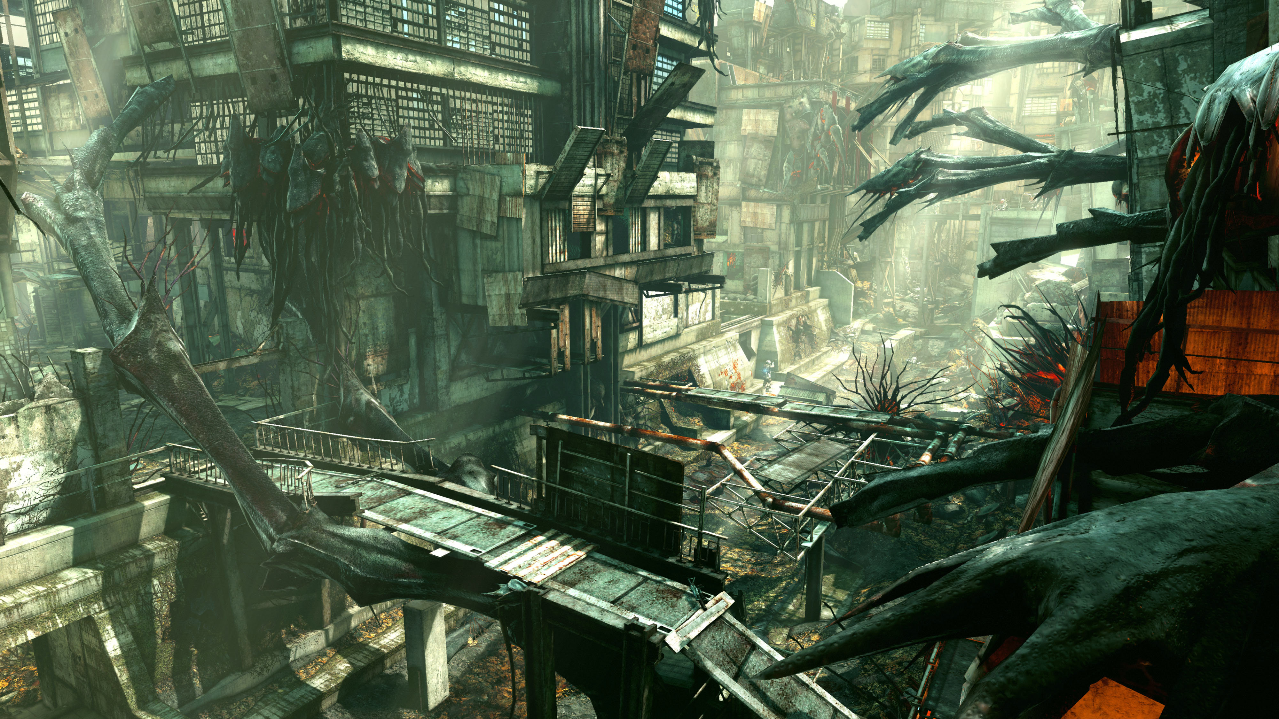
Talk takeaway
Occlusion culling system used in Killzone 3
You’ll love software rasterization
(Some) technical details
How to pick good occluders
Q&A
Huge environments
Notes:
The game is set in huge detailed outdoor environments…
Where you can fly around with an armed jetpack...
And you get to fight giant spider robot.
Twice.
Killzone 3 is a big game
and we needed good object visibility solution
that works well with these diverse settings.

Slide 6
Talk takeaway
Occlusion culling system used in Killzone 3
You’ll love software rasterization
(Some) technical details
How to pick good occluders
Q&A
Armed JetPacks
Notes:
The game is set in huge detailed outdoor environments…
Where you can fly around with an armed jetpack...
And you get to fight giant spider robot.
Twice.
Killzone 3 is a big game
and we needed good object visibility solution
that works well with these diverse settings.

Slide 7
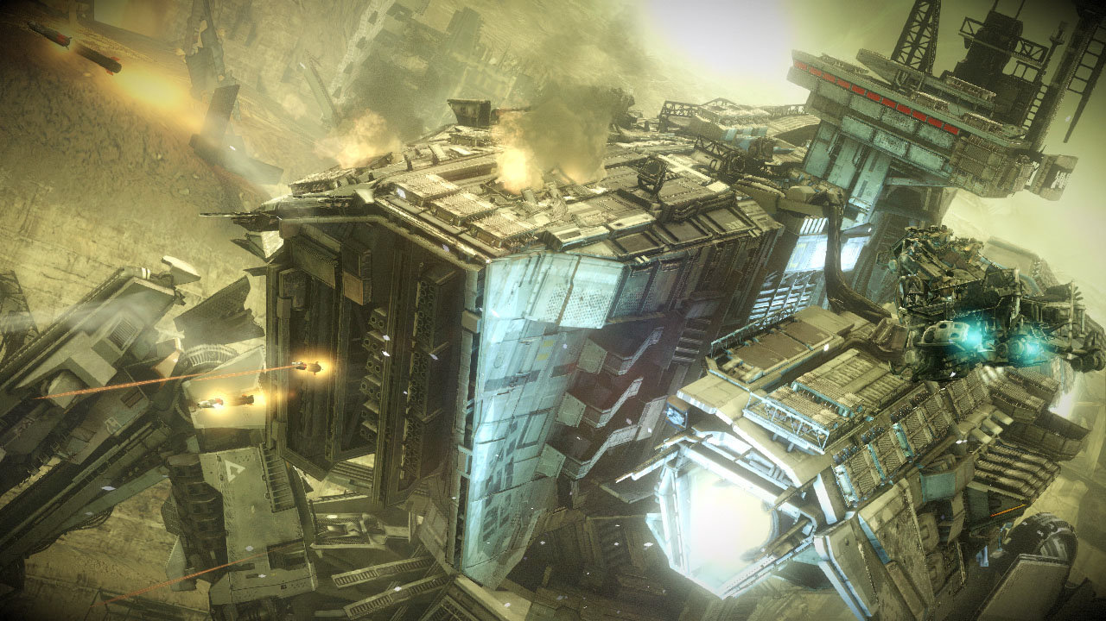
Talk takeaway
Occlusion culling system used in Killzone 3
You’ll love software rasterization
(Some) technical details
How to pick good occluders
Q&A
Giant Spider Robots
Notes:
The game is set in huge detailed outdoor environments…
Where you can fly around with an armed jetpack...
And you get to fight giant spider robot.
Twice.
Killzone 3 is a big game
and we needed good object visibility solution
that works well with these diverse settings.

Slide 8
Killzone 3 visibility solution
Software rasterization running on SPUs
Render occluders into depth buffer
Use simplified version of the scene geometry
Conservatively scale down
To make it fit into SPU memory
To make it faster to test against
Test all objects against small depth buffer
Test bounding boxes
Notes:
We chose to try software rasterization running completely on SPUs.
We render the simplified version of the level geometry
into a depth buffer (these are the occluders)
And we then use scaled down version of this depth buffer
to test visibility of all objects or lights in the current view frustum.
The test itself uses bounding box of the objects.

Slide 9
Why software rasterization
Previous solution did not scale well
Manually placed portals
Notes:
I'll try to summarize the reasons why we chose this solution
and I'm sure you recognize some of your own experiences here.
First and foremost we saw that our solution based on portals
does not scale well with the big outdoor levels.
Especially since our portals were hand placed by artists and we were
running into production stalls.
Very important issue if you try to create the game in two years.

Slide 10
Why software rasterization
Previous solution did not scale well
Manually placed portals
Works automatically
Can be enabled early in production
Notes:
The process of occluder creation can be made largely
automatic and can be enabled from the early days of production.
The whole concept of occluders is very similar to building
of regular geometry and it's easy to understand by artists.
This makes it very easy to step in and manually create occluders where needed.

Slide 11
Why software rasterization
Previous solution did not scale well
Manually placed portals
Works automatically
Can be enabled early in production
Completely dynamic solution
Any object can become an occluder
Notes:
Unlike most other approaches, this one is completely dynamic.
Any sufficiently large object on screen can serve as a good occluder.
If you're hiding behind a destructible barrel or a metal plate in our
game, it is an occluder.
Doors can open and close and they perfectly block the visibility
without you having to write special code for such case.

Slide 12
Why software rasterization
Previous solution did not scale well
Manually placed portals
Works automatically
Can be enabled early in production
Completely dynamic solution
Any object can become an occluder
Maps well to SPUs
No sync issues
No GPU costs related to visibility testing
Notes:
Software rasterization maps well onto SPUs - it's easy to distribute
and SPUs are generic enough to allow us to run complicated object culling logic.
And unlike GPU based solutions, you get exact results
within the same frame without complicated synchronization logic.

Slide 13
Notes:
Let’s look at the example of how the occlusion system works.

Slide 14
Notes:
If we look from the side, you see we don’t
render anything behind the closed door.
But as soon as the door open...

Slide 15
Notes:
...we start to render the rest of the visible scene.
As I mentioned earlier, this
happens entirely automatically.
And since I forgot to record the occlusion
depth buffer, you’ll have to trust on this one.

Slide 16
Implementation overview
Notes:
We implemented the system as series of SPU jobs.
Most run in parallel to do the heavy lifting.

Slide 17
Occluder setup
First stage, not parallel
Outputs clipped + projected triangles
One list of triangle data
One “index” DMA list per rasterizer job
Caches are important at this stage
2KB vertex array cache (90% hit rate)
32-entry post-transform cache (60% hit rate)
Various double-buffered output caches
Notes:
The first SPU job loads visible occluder primitives and outputs clipped and projected triangles for rasterization. A single list of triangles is shared between the rasterizer jobs, and each job has its own DMA list pointing to the subset of triangles it needs to draw.The occluder primitives are identical to visual meshes, with vertex and index arrays. Therefore we introduced several caches to
reduce bandwidth and vertex transformation costs. This setup is very similar to what you find in a GPU.

Slide 18
Rasterization
Split 640x360p depth buffer into 16 pixel-high strips
Rasterize in parallel, one SPU job per strip
Load triangles using the prepared DMA list
Traditional scanline rasterizer
Fill internal 640x16 floating point depth buffer
Vectorization is the key
Set up three or four edges at once
Generate 4x1 pixels at once
Optimize in assembly
Notes:
We split our depth buffer into 16-pixel-high strips and run one rasterize job per strip in parallel.Each rasterize job loads the list of triangles that intersect with its strip using the DMA list prepared by the setup job.We perform standard scanline rasterization into an internal floating point buffer. The rasterize jobs are compute-bound, and the code is
extensively vectorized to improve throughput. Inner loops are written in SPA assembler.

Slide 19
Rasterization
Compress depth buffer
One output pixel is maximum depth of 16x16 block.
But patch single pixel holes first.
Encode as uint16, reserve 0xffffu for infinity
Output single scanline of 40x23 occlusion buffer
Notes:
For output, we conservatively compress the depth buffer. Each output pixel is the maximum depth value of a 16x16 pixel tile in the depth buffer.Before compression, we patch single pixel holes to avoid leaks
when the occluders are not water-tight. This is a bit of a cheat, but it’s necessary otherwise such hole pushes the tile way into the background.The last step encodes depth into 16 bits,
Occluder frustum is shorter than visual frustum so we
reserve one bit for points behind occluder far plane.

Slide 20
Occlusion tests
Tests happen in parallel
Each object consists of one or more parts
First test object bounding box
Skip for objects visible last frame
Then test individual parts
Continue with submesh culling
Small Spatial Kd-Tree inside most meshes
Allows for culling arbitrarily small mesh chunks
Notes:
The last step is the actual visibility testing. We have one job that gathers all objects in the camera frustum and then spawns an occlusion test job for each batch of objects.We have a two level hierarchy of objects and meshes
objects live in the scene, and meshes are what we send to the GPU. We test objects first to avoid testing meshes.If a mesh has many triangles, we can continue with submesh culling. This uses the mesh’s Kd-tree to cull away whole ranges of mesh triangles. Visible meshes form new primitive sent to GPU.The output of these jobs is the final result of the occlusion query, and is sent for rendering.

Slide 21
Occlusion tests
Accurate tests
Bounding box rasterization and depth test
Working on small depth buffer, be conservative
Fast bounding sphere tests
Precomputed hierarchical reject data
Constant time test for small spheres
Only used for fast reject
Notes:
We have two kinds of visibility test we can use to cull objects and parts.The basic test is the most accurate, but also the most expensive. It rasterizes a bounding box with depth testing against the small occlusion buffer.
We also have constant-time tests for small objects. We precompute several versions of the occlusion buffer by conservatively dilating the depth values. This allows us to perform very quick bounding sphere tests.If an object passes the fast test, or if it is too large, we do the accurate test.

Slide 22
Generating good occluders
Notes:
In the final part of the presentation I’d like
to explain how we create occluders.

Slide 23
Where to get occluders
Aiming for automated solution
Originally wanted to use scene geometry
Reduced polygon count
Too many errors, in general does not work
Now using physics mesh
Closed, low polygon meshes
Not always conservative in the right sense
Visual mesh can be inside physics mesh causing drops
Notes:
We didn’t want artists to hand-make occluders
for the entire level, so we looked for an automatic solution.
We experimented with using visual meshes,
but the good polygon reduction proved
to be difficult to get right.
Physics mesh is much better choice.
It’s available for each mesh in the game
and it’s cleaned and sufficiently low polygon count.
Unfortunately the physics meshes can be slightly larger
than visual meshes causing objects to disappear.
Worst offenders have to be fixed manually.

Slide 24
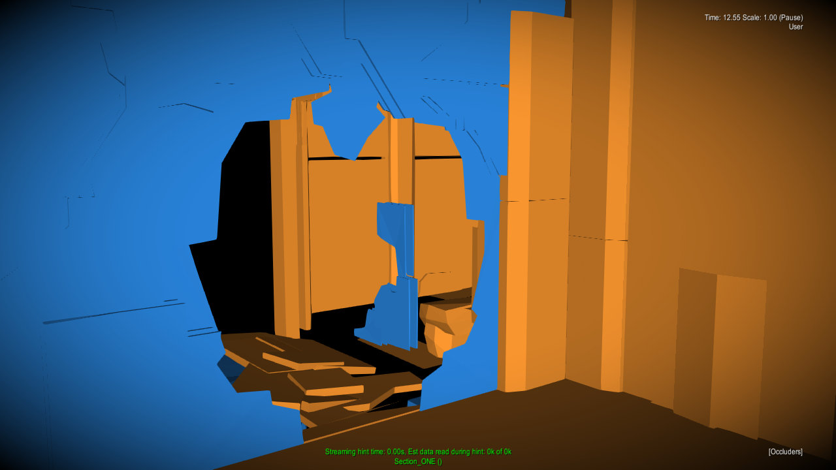
Where to get occluders
Notes:
Here’s an example of occluders
generated automatically from physics mesh.
You can notice there’s some unnecessary detail,
but in general the quality is pretty good.

Slide 25
How to select good occluders
Simple heuristics to identify good occluders
Discard anything which is small
Discard by meta data
clutter, set dressing, foliage, railings…
Discard if surface area is significantly smaller than bounding box surface area
Artists can override the process
Still creating the best occluders by hand
Notes:
Even using physics mesh there was too much occluder geometry.
We needed to reject occluders that were unlikely to
contribute much to the occlusion buffer.
Our simple heuristics rejects all small objects or
objects where the name suggests that they are not good occluders.
We also reject meshes whose surface area suggests
that they are thin or with too many holes.
Artists can of course step in and override the heuristics
or provide their custom occluders for difficult cases and optimization.

Slide 26
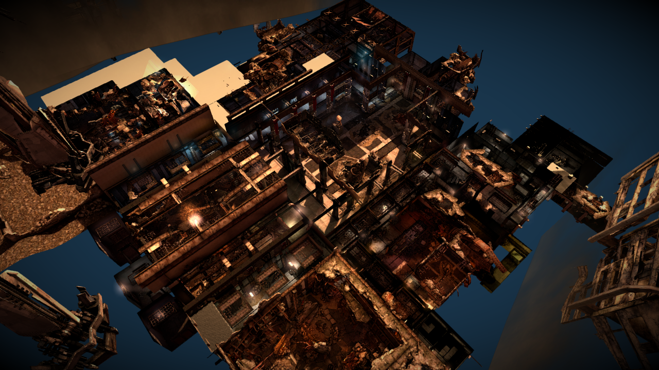
Artist generated occluders
Notes:
Here’s an example of KZ3 multiplayer level where the
automatic heuristics did not work well.

Slide 27
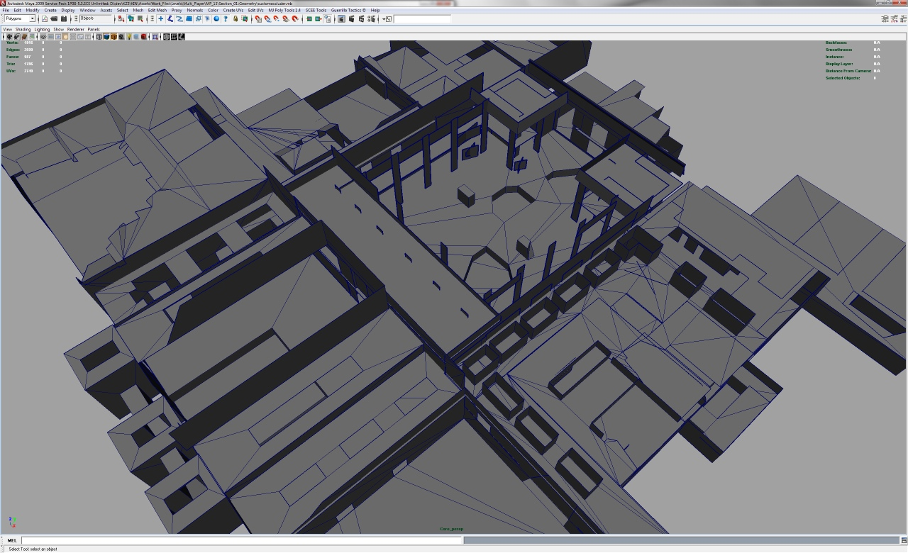
Artist generated occluders
Notes:
And here’s the highly optimized occluder mesh created by artist.

Slide 28
Conclusion
Software rasterization is great
Fast on SPUs
Easy to integrate
Very accurate (if occluders are accurate)
Creating occluders is hard
Automatic system was not enough
Plan for this in content creation
Define workflow for finding and fixing leaks
Voxelization anyone?
Notes:
We like this system, it’s simple, efficient and fits well with our pipeline.
Unfortunately the content creation proved to be a problem.
The automated solution did not work well enough in some cases
and artists had to create custom occluders for entire levels.
Luckily the geometry is easy to create.
Using scene voxelization might be a good way
to generate simple, robust occluders automatically.

Slide 29
Conclusion
Special thanks to Will Vale (Second Intention Ltd) for implementing this system for us.
Notes:
I’d like to thank Will Vale for implementing the
system for us and help with this presentation.

Slide 30
Statistics
100 occluders, 1500 triangles
Test 1000 objects, 2700 parts
Timings
Setup job: 0.5ms
Rasterize job: 2.0ms (on 5 SPUs)
Query job: 4.5ms (on 5 SPUs)
Overall latency: ~2ms
Notes:
Questions?

